Slide 1
Practice Improvement Institute
Rapid Job Placement Series: Now is NOT the Time to Ask “Is the Family On Board?”
January 15, 2015 9:00-10:00 EST

Slide 2
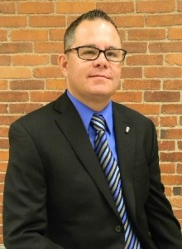
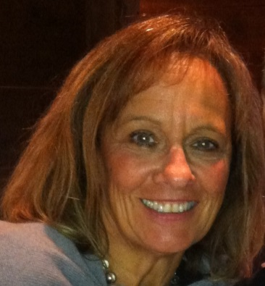
Practice Improvement Institute Faculty: Rapid Job Placement Series
Lorrie Lutz
Fedcap’s Chief Strategy Officer
Eugene Gloss
Director of Programs in New England
Donna Keefe
New England Director of Admission and Client Services
Wil Edwards
Business Developer

Slide 3
Rapid Job Series Description
January 8, 2015 9:00-10:00 Webinar
Part I: Within 3 hours! From confirming a job exists to identifying candidates. This module will share tools and strategies to ensure the job readiness of program participants.
January 9, 2014 9:00-10:00 Webinar
Part II: Within 72 hours! Candidate Identification to Interviews! This module will discuss the candidate selection process, engagement of participants and the obvious and less obvious components of readiness process for interviews—including preparing employers.
January 15, 2015 9:00-10:00 Webinar
Part III: Now is NOT the time to ask… Is the family on board? This module will address ways to engage families and help them overcome their fears.
January 16, 2015 9:00-10:00 Webinar
Part IV: First 30 Days of Employment . This module discusses the challenges that can arise during those critical first days.

Slide 4
Rapid Job Placement
Description: This five part training provides a detailed, step by step approach to helping individuals with intellectual/developmental disabilities rapidly move into the community based, competitive employment environment.

Slide 5
Definition of the Family
For the purpose of this discussion the family includes the individual’s biological family (parents, siblings, etc.) legal guardians or individuals serving in caregiving role in group care or small home living environments

Slide 6
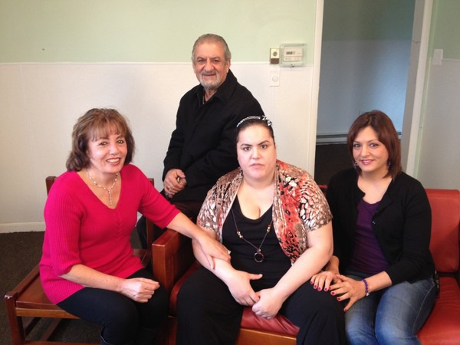
Family Engagement in the Process
When/How to introduce the family to the job process:
ISP/Career Plans
Family gatherings
Family to Family Interactions
Family participation in Integrated Day Activities
Families going to Job Sites with Business Developers

Slide 7
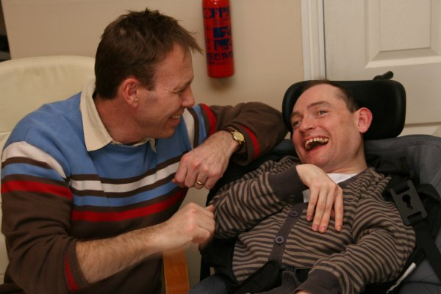
Family-Participant Interaction
When other participants are excited about working –this can be contagious!
Yet when the participant goes home and shares that excitement...
They can be met with:
Discouraging statements
Statements that result in a participant becoming reluctant to pursue employment
High degree of protection
More questions than supportive statements

Slide 8
UNDERSTANDING AND ADDRESSING THE FEAR
Basis of the fear:
Protective instinct
Unknown
“Tried it before and it did not work”
Makes life more complex and messy
Sometimes it is not fear, it is guilt
“Does this mean that what I have been doing is wrong?”
Have I hurt my child by not insisting that they go into the community sooner?”
Sometimes the family’s reaction is based on financial concerns

Slide 9
Fear of Losing Benefits May Play a Large Role in Family Reactions
The money may not seem like a lot --but it means a lot to many families
It is part of the family’s overall income stream
Families need to understand the impact of the potential (and real) loss of some benefits
ORS is a strong partner in benefits counseling

Slide 10
Voice of a Family Member
Ways to change perspectives
From one family member to another
Gatherings to talk about their concerns
Letters from family members describing their experiences
Family to family mentors and coaches

Slide 11
Voice of the Participant
Sometimes when family members discourage participants from pursuing work...
Participants do not want to argue or disappoint them
So they say that they do not want to go to work...
Helping the participant talk to their family about work is an important step in the process

